Slide 1
Localization
29 August 2011
Notes:
10-Dec-07 Page <number>
Guidewire training materials contain Guidewire proprietary information that is subject to confidentiality and non-disclosure agreements. You agree to use the information in this manual solely for the purpose of training to implement Guidewire software solutions. You also agree not to disclose the information in this manual to third parties or copy this manual without prior written consent from Guidewire. Guidewire training may be given only by Guidewire employees or certified Guidewire partners under the appropriate agreement with Guidewire.

Slide 2
Lesson objectives
By the end of this lesson, you should be able to:
  Set up a new locale
  Manage display keys for new locale
  Understand platform support for international features
  This lesson uses the notes section for additional explanation and information.
  To view the notes in PowerPoint, choose View→Normal or View→Notes Page.
  If you choose to print the notes for the lesson, be sure to select “Print hidden slides.”
Notes:
10-Dec-07 Page <number>

Slide 3
Lesson outline
Localization basics
Setting up a new locale
Localizing display keys, typecodes for new locale
Localizing shared admin data
Regions and zones
Using a localization pack
Notes:
10-Dec-07 Page <number>

Slide 4
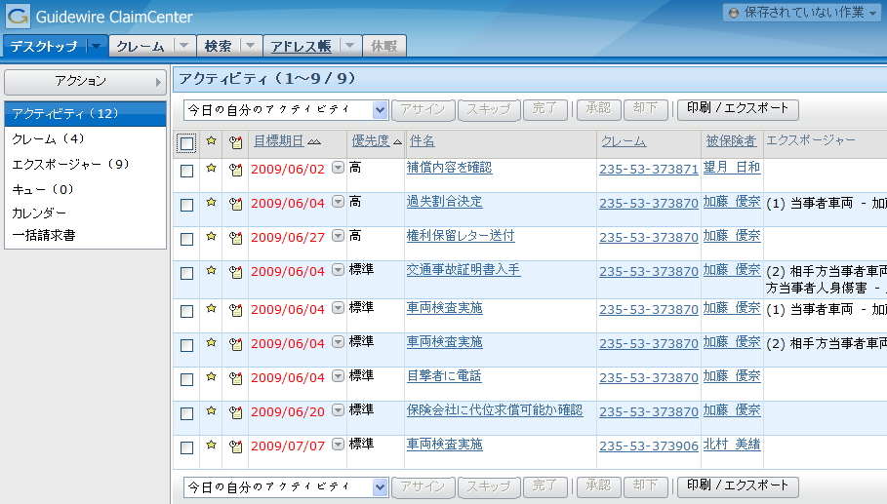
Localization
Localization is the act of translating and adapting a product so that it is appropriate for use in other countries or languages

Slide 5
What is localizable?
Localization allows you to translate:
  Studio and application UI for entering values
  Labels for screen names
  Description of custom history events
  Subject and description in activities
  Widgets and other display elements
Notes:
ClaimCenter allows you to customize the values shown in the interface so that they are appropriate for your locale. For example, even though the LossType code would be expected to be the same in all languages, the description might be different depending on the language of the user viewing it.

Slide 6
How to localize?
Locale is a combination of language and formats
Key configuration resources are:
  LanguageType typelist – Sets the language options available from the ClaimCenter interface
  localization.xml – Defines the locales available in ClaimCenter

Slide 7
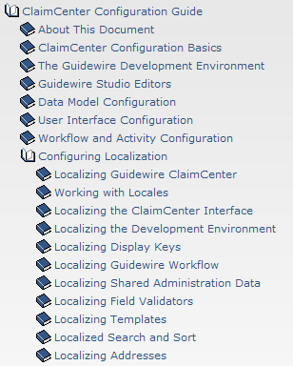
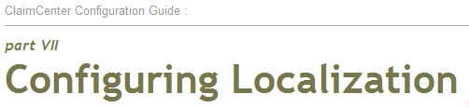
Use the documentation
Localization is a very big topic
This lesson is meant to give a taste
The documentation has more
depth and breadth on the
subject – use it!

Slide 8
Lesson outline
Localization basics
Setting up a new locale
Localizing display keys, typecodes for new locale
Localizing shared admin data
Regions and zones
Using a localization pack
Notes:
10-Dec-07 Page <number>

Slide 9
Setting up a new locale
Following are the steps to set up a new locale
  Add a language entry to LanguageType
  Define a locale using the new language in localization.xml
  Set defaults in config.xml
  Set a user’s default locale (optional)
Notes:
10-Dec-07 Page <number>

Slide 10
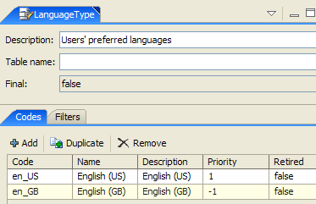

1. Add a language
Name of the language as it appears in the application
The code will be used when defining the locale in the next step
Notes:
Every entry in the LanguageType typelist is going to be used by a locale.
10-Dec-07 Page <number>

Slide 11
2. Define a locale – GWLocale element
GWLocale element defines a locale
  It has three parameters:
    name
    code
    typecode – code from the LanguageType entry to be used by this locale
  It has four format element tags:
    DateFormat
    TimeFormat
    NumberFormat
    CurrencyFormat
Notes:
GWLocale code parameter: The Java standard for locale codes states that you can specify codes in an xx, xx_yy, or xx_yy_zzz format. The components of these formats are:
xx (required) - The two-character lowercase ISO 639-1 code for that language. To view a list of valid codes, refer to following web site: http://www.loc.gov/standards/iso639-2/php/English_list.php
yy (optional) - A two-character uppercase ISO 3166-1-alpha-2 code for a country. To view a list of countries, refer to the following web site: http://www.iso.org/iso/english_country_names_and_code_elements
zzz (optional) - A custom string. For example, you can use this define regions within a country. You can make the string any length.
DateFormat/TimeFormat: Within a locale, you can specify local formats for date (DateFormat), time (TimeFormat), numbers (NumberFormat), or currency (CurrencyFormat).
The DateFormat and TimeFormat attributes allow you to specify short, medium, and long forms for each. User can specify any of the date and time patterns supported by the Java class SimpleDateFormat.
NumberFormat: The NumberFormat determines how numbers are displayed. The thousandsSymbol separates groups of three digits to the left of the decimal mark. This is typically a comma, period, or space. The decimalSymbol separates a whole number from its decimal fraction. This is typically a period or comma.
CurrencyFormat: The CurrencyFormat controls how currencies are displayed.
The positivePattern and negativePattern parameters define how ClaimCenter displays positive and negative currency values. ClaimCenter renders the character # (pound sign) with the actual number, but display all other characters in the pattern literally. For example, the positivePattern $# displays the value 32 as $32, and the negativePattern ($#) displays the value -5 as ($5). The pattern can include more than one character, such as #USD to display as 5USD.
The zeroValue parameter defines how ClaimCenter displays zero or null values. For example, this can be 0 (zero) or — (dash).
Note: It is important that you always display currency values correctly for the current locale. For example, if using a single currency, $10 in English can be represented as 10 USD in German. In both of these cases, however, the currency unit is dollars. It would be a serious misrepresentation of your financial data to use a $ symbol for one locale and a € symbol for another. (10 dollars is not equal to 10 euros, at least not at the current exchange rate.)
10-Dec-07 Page <number>

Slide 12
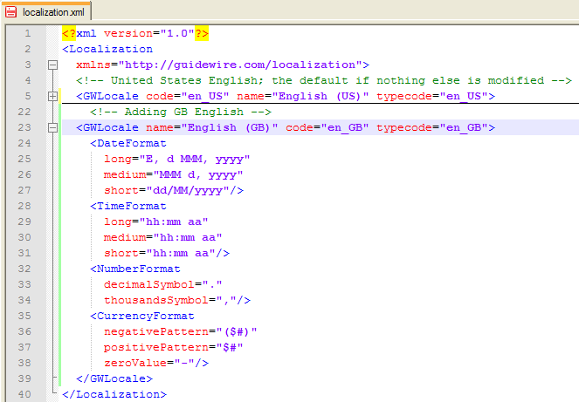
localization.xml
English (GB)
locale is added
Currency in dollars
Notes:
Note that even though this is a Great Britain locale, the CurrencyFormat is still for the US Dollar ($). Defining additional locales in the localization.xml file does not change the currency for any specific locale, so all the financials will still be in US Dollars.
Multicurrency information can be found in the Multicurrency lesson.
10-Dec-07 Page <number>

Slide 13

3. Set defaults in config.xml
Set the DefaultApplicationLocale parameter
  Value must match the code attribute of one of the GWLocale definitions
  If application can not find a GWLocale with the matching code, it uses en_US as the default locale
Set the DefaultCountryCode parameter
Set the DefaultApplicationCurrency parameter
Notes:
All of these parameters should be left with the standard settings if your new locale is not meant to be the default.
10-Dec-07 Page <number>

Slide 14
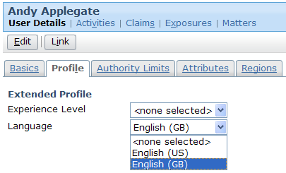
4. Set a user’s default locale (optional)
Following are the steps to set up a user’s default locale
  On the Administration tab, find the user that you want to edit
  On the user’s Profile page, click Edit
  In the Language drop-down list, select a locale.
Notes:
A user can switch his own locale for a given session, but he cannot change his own default in the base configuration.
10-Dec-07 Page <number>

Slide 15
Lesson outline
Localization basics
Setting up a new locale
Localizing display keys, typecodes for new locale
Localizing shared admin data
Regions and zones
Using a localization pack
Notes:
10-Dec-07 Page <number>

Slide 16
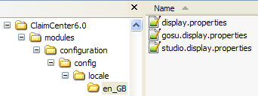
String resources in the application
Strings that can be translated within studio:
  Typelist values
    Stored in individual typelist files
  Display keys / error messages
    Stored in three display.properties files:
      Application → display.properties
      Studio → studio.display.properties
      Gosu → gosu.display.properties
Notes:
A locale folder stores all display.properties at: ClaimCenter/modules/configuration/config/locale/xx_XX
It is recommended that you convert all hard coded strings to display keys if you need to translate them. This will make the translation process easier.

Slide 17
Localizing application strings
Export existing display.properties file
  Also exports typelists
Translate to new language
Import translated file for new locale

Slide 18
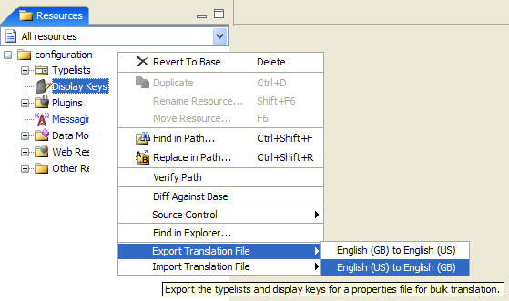
Step 1: Export existing display.properties file
Right-click either Display Keys or Typelists
  Click Export translation file and then click the option from the source to the target locale
  Save file for translating
Notes:
“Export translation file" exports both display keys and typelists to the same file, regardless of which one you right-clicked on - so you only have to do it once. Every localized copy of this file has a full set of keys (and is thus the same size as the primary locale's file.)
The options available in the submenu in bullet 1.1 depend on the locales defined. There will be options to export from each locale to every other locale. It is most typical to export from the primary locale to each of the other locales, but there are situations when you might want to use the other options:
On some projects, the primary locale is not the locale being used for development. In that situation, the primary locale isn't the locale that will be used as the source for translation.
If you are translating from one source locale to multiple similar target sources, it might make sense to export from the primary locale to the first target locale, translate and import, then export from the first target locale to the second target locale (to take advantage of the similar translations.)
If you have not created additional locales, you can only export the default en_US display.properties file.

Slide 19
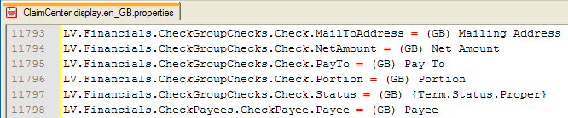
Step 2: Translate to new language
Edit saved file, adding translated values
Do not modify the display key names
Notes:
For demo purpose, the translated values all have "(GB)" before the text. In a real world situation, the user will have to enter localized values as desired for each display key string.

Slide 20
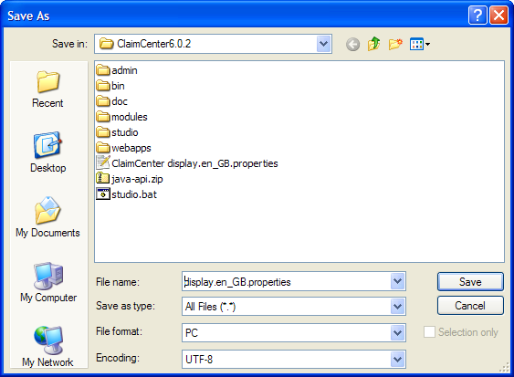
Display accented and special characters
Always save display.properties files as type UTF-8 encoding for correct display of characters
Notes:
Even if you don't have accented characters, save the files as UTF-8.
Note that if you are using Notepad++, the encoding decision is made in the Format menu, not during the Save process.

Slide 21
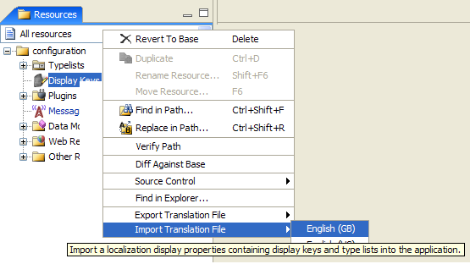
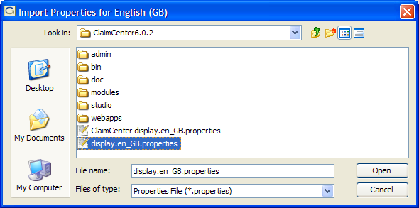
Step 3: Import translated file for new locale
Right-click either Display Keys or Typelists
  Click Import translation file and select the target locale
  Navigate to and open the translated file
Notes:
The file imports should be the same as the one user edited and saved in UTF-8 format.
Localization Import imports the display.properties file for the locale of your choice. When you import the file a <locale_name> folder is created under your locale folder with display.properties file which has the localized strings. For the example, above an en_UK folder got created and a display.properties gets created in it with the UI localization string values.

Slide 22
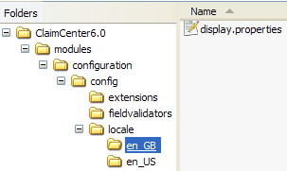
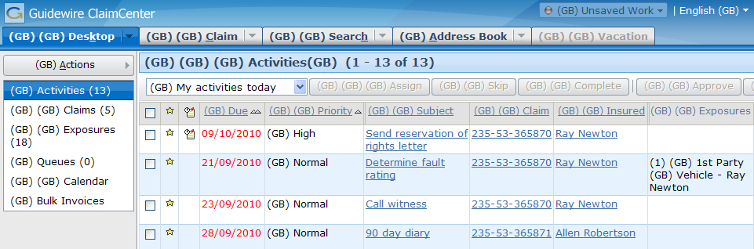
Result of import
New language folder
created in configuration
directory
Localized display keys in UI when new locale selected
Notes:
Note that the simple "translation" of prepending "(GB)" to every display key value has some unexpected consequences, since some of the display keys are built based on concatenations of other display keys.

Slide 23
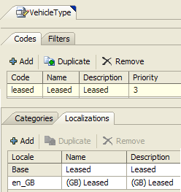
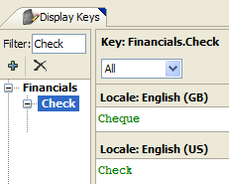
Individually localizing display keys, typecodes
Display keys and typecodes can also be edited in Studio
  Display Key Editor
  Localization tab on each
  typecode
Notes:
In the Display Key Editor, you can select "All" to see all the localizations at one time.
10-Dec-07 Page <number>

Slide 24
Localizing Studio strings
Display keys within Studio have to be localized manually with these steps:
Copy ..\modules\cc\config\locale\en_US\studio.display.properties
to ..\modules\configuration\config\locale\en_US\
Open ..\modules\pl\config\locale\en_US\studio.display.properties
  Select and copy all contents of this file
  Append these contents to ..\modules\configuration\config\locale\en_US\studio.display.properties
Copy appended file to ..\modules\configuration\config\locale\en_GB
Edit localized string values in each file as required
Save file as UTF-8
Restart Studio
To see localized strings, you must choose the locale within Studio
Notes:
The two files in the configuration directory are the ones that can be edited. The one in the new language is expected to receive most (if not all) of the edits.

Slide 25
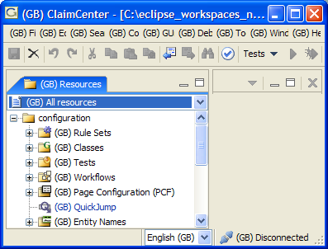
Localized Studio
Locale selector appears in Studio for user to be able to switch to another locale
Appears only after:
  localization.xml has a
  GWLocale tag for another
  locale
  studio.display.properties
  exists for another locale
  in your configuration
  directory
Localized strings in Studio
Locale selector added in Studio

Slide 26
Localizing Gosu error messages
Gosu error messages have to be localized manually with these steps:
Copy ..\modules\pl\config\locale\en_US\gosu.display.properties
to ..\modules\configuration\config\locale\en_GB\
Edit localized string values as required
Save file as UTF-8
Restart Studio
To see localized strings, you must choose the locale within Studio
Notes:
The two files in the configuration directory are the ones that can be edited. The one in the new language is expected to receive most (if not all) of the edits.

Slide 27
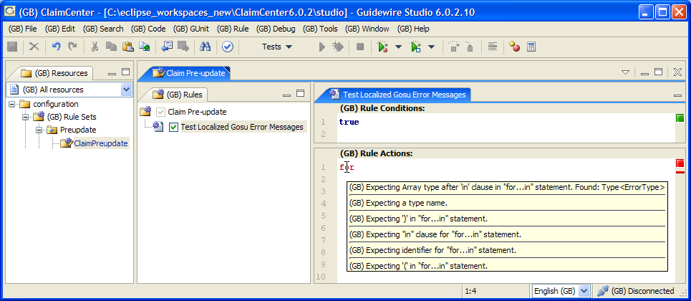
Localized Gosu error messages
Appears only after:
  localization.xml has a GWLocale tag for another locale
  gosu.display.properties exists for another locale in your configuration directory
Localized Gosu error messages
Locale selector added in Studio
Notes:
The error messages appear when you hover your mouse over the problem code.

Slide 28
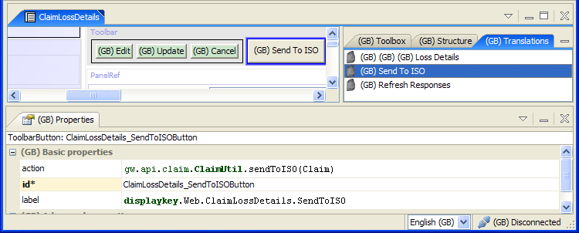
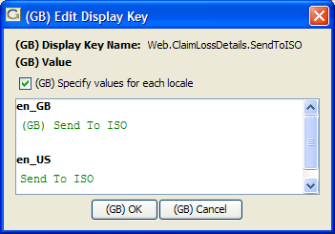
PCF editor Translations tab
Translation tab lists every display key used in the current PCF file
Double clicking the translate icon opens display key editor
Display key name edited here
Notes:
A display key file is essentially a list of words is in the display.properties files which is sent off to a translator, who returns back the same list of words in a different language. Real translation doesn't turn out to be so clean-cut; often there are multiple possible translations of a given phrase or word, and without knowing the context in which it's used, it's impossible to tell which one is right.
So what happens in the real world is that the implementation team ends up correcting the translation, which involves a lot of digging around in the PCF editor, then jumping back and forth between the PCF editor and the display key editor. This process is made easy with the use of Translation tab which collects and displays all fields in the PCF that can be localized. Hence the user can jump to the field he wants to edit quickly.
10-Dec-07 Page <number>

Slide 29
Lesson outline
Localization basics
Setting up a new locale
Localizing display keys, typecodes for new locale
Localizing shared admin data
Regions and zones
Using a localization pack
Notes:
10-Dec-07 Page <number>

Slide 30
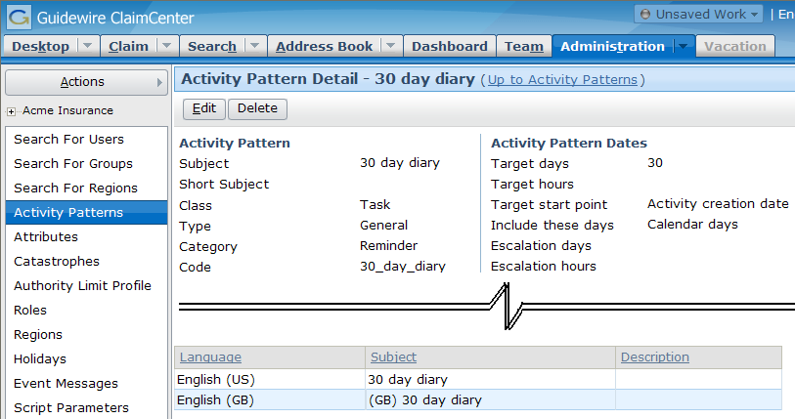
Localized entities
Admin data can be dynamically added, and shared by multiple locales
  Examples: activity patterns, catastrophes
Notes:
In the example shown on the slide, we can see that activity patterns have two localized fields – Subject and Description.

Slide 31
Configuring localized entities
ClaimCenter provides mechanism to make user-visible text for this data localizable
  Extend data model
    Store localized values for certain columns
  Edit admin PCF
    Allow localized values to be added for localizable columns
    Add list view to the entity's detailed view to enable data entry
Notes:
To accommodate multilingual users who want to use shared administration data, Guidewire provides a two-step mechanism to create a database column on an entity that stores localization information.
Details on these two steps are on the following slides.
Note that there is no step required on any of the PCFs that reference the admin data. ClaimCenter knows to use the localized data when a different locale is selected.

Slide 32
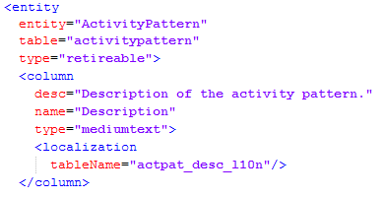
1. Extend data model
Syntax:
<entity entityName="entityName">
<column name="newName">
<localization tableName="entityAbr_colAbr_l10n"/>
</column>
</entity>
Notes:
This data model extension tells ClaimCenter that this particular field is localizable.
There is similar syntax for entity extensions, and/or column overrides.
<extension entityName="entityName">
<column name="newColName" desc="newColDesc" type="mediumtext">
<localization tableName="entityAbr_newColAbr_l10n"/>
</column-override>
<column-override name="existingColName">
<localization tableName="entityAbr_existingColAbr_l10n"/>
</column-override>
</extension>

Slide 33
Localized columns
Each column to be localized gets a <localization> tag, with a single attribute, tableName
  Creates an array of values for this column, one entry for each locale.
tableName properties:
  Names the join table where localized column data is stored
  Name must not exceed 16 characters
  Name made up of three parts, separated by underscores:
    An abbreviation of the entity name
    An abbreviation of the column name
    The text "l10n"
Notes:
In case it is not clear because of the font, that text is "L10N" with lowercase letters.
The value for the default locale is stored on the main entity. The values for any other locales are stored in the join table.

Slide 34
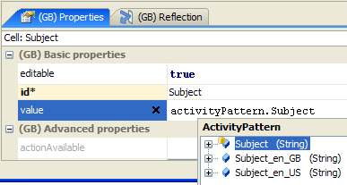
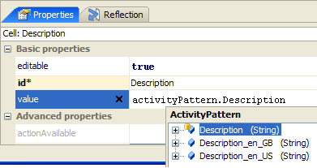
Localized values
The <localization> tag creates additional fields on the entity, one for each locale in the environment
  ActivityPattern example:

Slide 35

2. Edit admin PCF
Add ability for admin user to enter localized data
Create a PCF file, <entity>LocalizedLV
  Iterate over all LanguageTypes
    Add cells for the language name, and each localized column
      Use ActivityPatternLocalizedLV as a template
Reference the new LV from the <entity>Detail screen

Slide 36
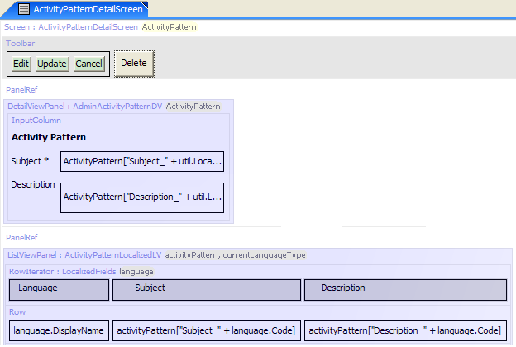
ActivityPattern example
Detail Screen
Detail View
List View
Notes:
Note: The examples you may find in ClaimCenter, including ActivityPattern and Catastrophe, all have variables defined on the LV called "currentLanguageType." This variable is vestigial, and may be ignored when you create your own LV for localized columns. The ClaimCenter team will remove these extraneous variables in a future release.

Slide 37
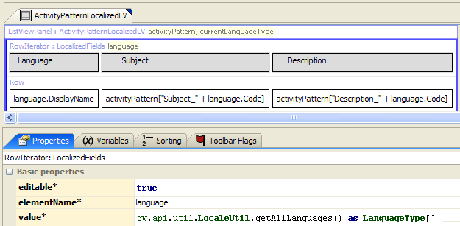
ActivityPatternLocalizedLV – row iterator
Iterate over all languages
  Get LanguageType array using call to gw.api.util.LocaleUtil.getAllLanguages() as LanguageType[]

Slide 38
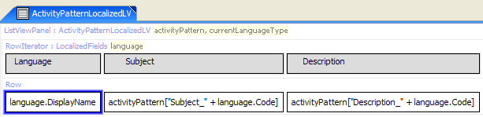
ActivityPatternLocalizedLV – cells
First cell holds language name
  value=language.DisplayName
Add additional cell for each localized column
  value= <entity>["<fieldName>_" + language.Code]
    Note that you are building the name of the localized field via concatenation
    Example: activityPattern["Subject_" + language.Code]
Notes:
This takes advantage of two Gosu entity facts:
You can always reference fields on an entity by using the syntax <entity>["<fieldName>"], which is equivalent to <entity>.<fieldName>.
The <localization> tag on entity columns creates an array of values for that column, each with the format <column name>_<locale>. Using the concatenation as shown in the ActivityPattern example gets the proper localized version of the field for the current row.

Slide 39
Lesson outline
Localization basics
Setting up a new locale
Localizing display keys, typecodes for new locale
Localizing shared admin data
Regions and zones
Using a localization pack
Notes:
10-Dec-07 Page <number>

Slide 40
Regions and zones
A zone is a postal address element or component
Each country has a different postal system, and thus has different zones
Within any one country, every zone is unique
A zone is defined using four properties
  Name: The name of the zone as shown in the user interface
  Code: The value of a zone that all searches and lookups use
  Zone type: The variety, or type, of the zone. Zone types Vary by Country
  Country: The zone’s country
Notes:
Typically, country zones break down along the lines of a postal address. Guidewire expects that you will import a zone dataset from a file that your company has purchased from a vendor. For example, you might have bought your data from a company like GreatData. You then use this dataset to plan your zone configuration. Each installation of ClaimCenter ships with US and Canada address data.
In planning, consider what parts of an address your users need to autofill. Also, what is the format of the zip or postal codes? Finally, note if any of the values are identical within a country. For example, does your country include two cities with the same name?
Generally a country can be broken into multiple zones. For example, you can divide your country, by county, state, and city. While planning your zones, consider that some of your zones can be referenced by another. For example, most cities reside within a single zone such as a state in the US or a province in Canada. ZoneType can be City, State, Province, etc. and vary by country
10-Dec-07 Page <number>

Slide 41
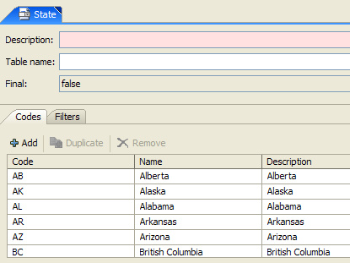
Zonetype: State
  The state typelist contains all US states and Canadian provinces
Notes:
10-Dec-07 Page <number>

Slide 42
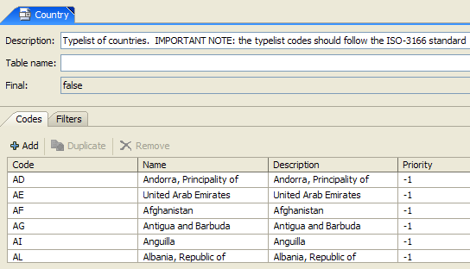
Zonetype: Country
  The Country typelist contains a list of countries and their two-letter abbreviations
  No other ZoneType has its own typelist
Notes:
10-Dec-07 Page <number>

Slide 43
Defining regions
  Regions are geographical areas which are defined as collections of zones
  Regions can be composed of multiple zone types if desired
Notes:
10-Dec-07 Page <number>

Slide 44
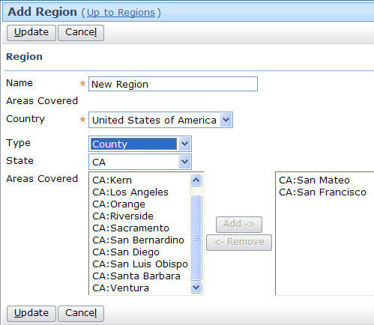
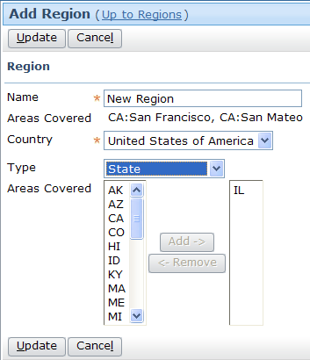
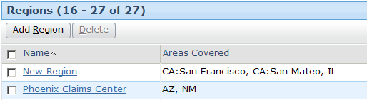
Defining regions (contd.)
2. State zones are also added to new region
1. New region is created and County zones are added
3. Result is region with zones of two zone types
Notes:
10-Dec-07 Page <number>

Slide 45
Configuring zone mapping
Assign by Location and autofill are now internationalized, and will function in different countries
Steps to setup zone mapping configuration for a country are:
  Determine how the customer wants to configure regions for assignment
  Create a zone-config.xml entry to match these requirements and the input data
  Format and import the zone data
Notes:
Determine how the customer wants to configure regions for assignment:
• What kinds of zones will make up the regions (this will dictate what ZoneTypes to define in the zoneType.xml typelist).
• In what order will the region match be done (this will dictate the values of the regionMatchOrder).
• How will zones be looked up if some zone data is missing from an address (this will define the Links).
• How will zone values be stored in the Address entity (this will determine the AddressZoneValue).
10-Dec-07 Page <number>

Slide 46
Zone mapper configuration file
  The file zone-config.xml tells both the mapping and auto-fill features (how to extract address elements from an address, in what order to try to match address elements how to fill in a missing address element)
  It specifies the following, for each ZoneType:
    regionMatchOrder
    ZoneCode
    AddressZoneValue
    Links
Notes:
10-Dec-07 Page <number>

Slide 47
Zone mapper configuration file (2)
  regionMatchOrder
    regionMatchOrder: Defines what order to use this zoneType to try to map a zone in an address to a region
  ZoneCode
    This describes how to extract a ZoneType code from an address in the correct format. Example: concat(Zone.State,Zone.County) concatenates the state with the County - producing the code of the County zone of an Address in the correct format. Optional; if not specified, use the zone’s name instead of its code
Notes:
10-Dec-07 Page <number>

Slide 48
Zone mapper configuration file (3)
  AddressZoneValue
    How to extract a ZoneType value from an address in the correct format. For example, if ZoneType=County, concat(Address.State.Code,Address.County,:) concatenates state and County address elements with a ":" in between. This is the county ZoneType, in its format. Optional; if unspecified; the address already contains a ZoneType value in the correct format
  Links
    Defines associations to other ZoneTypes. If a zone is missing from the address, use the linked Zone­Type to try to discover the missing zone value.
Notes:
10-Dec-07 Page <number>

Slide 49
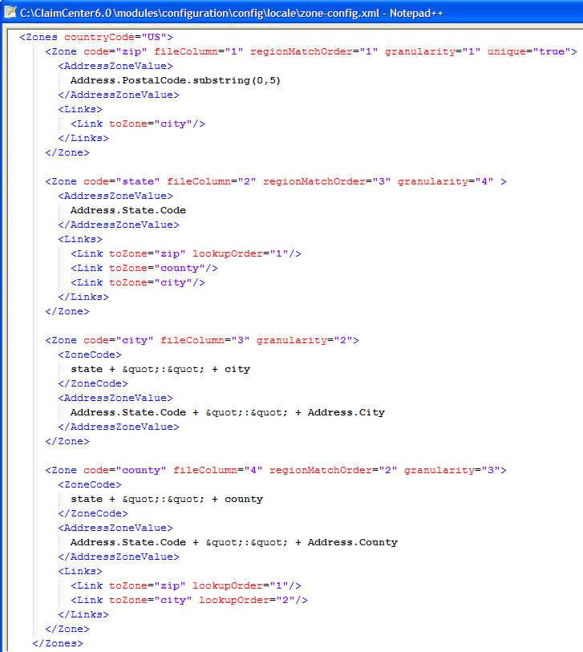
Zone mapper configuration file (4)
Configuration for US in zone-config.xml
Notes:
10-Dec-07 Page <number>

Slide 50
Lesson outline
Localization basics
Setting up a new locale
Localizing display keys, typecodes for new locale
Localizing shared admin data
Regions and zones
Using a localization pack
Notes:
10-Dec-07 Page <number>

Slide 51
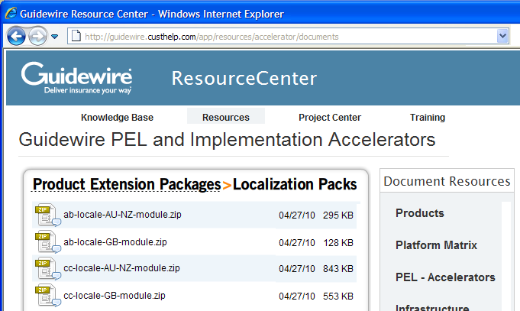
Localization packs
Guidewire provides optional non-US localization modules
  Supports application localization for specific countries
  Accessible from the customer portal
    Portal → Resources → PEL Accelerators → Localization Packs
Notes:
Localization packs are available for GB and for AU/NZ.

Slide 52



Steps to enable a localization pack
Download and install module to ClaimCenter\modules
  ..\ClaimCenter\modules\cc-locale-GB
Edit modules.xml
  Edit file directly, not from within Studio
  Add new dependency
  element to
  "configuration" module
  Add new module definition for
  your country-specific module
Refresh integration with
ContactCenter (optional)
Start ClaimCenter
Notes:
A more detailed version of these steps can be found in the ClaimCenter Configuration Guide, in the sections titled "Enabling Guidewire Localization Content".
2. modules.xml is one of the very rare cases where you will edit an application file outside of the ClaimCenter/modules/configuration folder.
You need to edit this file to update the module dependency relationships in ClaimCenter. Enabling this module requires adding it as a its own module, dependent upon the cc module, and adding a dependency on the configuration module to refer to this new module. The name of the new module must match the name of the folder from step 1.
3. Refreshing the ContactCenter integration is only required if you have integrated ClaimCenter with ContactCenter.
Note that the cc-locale-XX module behaves the same way as the other core modules in terms of dependency and overrides. In a core implementation, any file in the configuration module would override the same file in the cc module, which would override the same file in the pl module. The new locale module slots between the configuration and cc modules (overridden by the former and overriding the latter.)
One specific item of importance is that the cc-locale-XX module includes its own version of the config.xml file, so editing config.xml in Studio will start with the localized version of this file rather than the one in the cc/config directory.

Slide 53
Review questions
What is localization?
Which steps will you follow to set up a new locale?
What are the regions? What is the change in this upgrade?
Where do you define multiple currencies?
Which are the elements of zone-config.xml?
Notes:
10-Dec-07 Page <number>
Answers
Localization is the act of translating and adapting the viewable text in the ClaimCenter interface (and Studio) so that it is appropriate for use in other countries or languages
Following are the steps to set up a new locale
Define a locale
Make the locale available
Set the default application locale
Set a user’s locale
Regions are geographical areas which are defined as collections of zones. In previous to ClaimCenter 5.0, a region could consist of a collection of either states, zip codes, or Counties, but could not contain more than one of these zone types. It can be done now.
currencies.xml
Specify the following for each zone type
regionMatchOrder
ZoneCode
AddressZoneValue
Links

Slide 54
Notices
Copyright © 2001-2011 Guidewire Software, Inc. All Rights Reserved.
Guidewire, Guidewire Software, Guidewire ClaimCenter, Guidewire PolicyCenter, Guidewire BillingCenter, Guidewire Reinsurance Management, Guidewire ContactManager, Guidewire Vendor Data Management, Guidewire Client Data Management, Guidewire InsuranceSuite, Guidewire ContactCenter, Guidewire Studio, Gosu, Deliver Insurance Your Way, and the Guidewire logo are trademarks or registered trademarks of Guidewire Software, Inc. in the United States and/or other countries.
This material is Guidewire proprietary and confidential. The contents of this material, including product architecture details and APIs, are considered confidential and are fully protected by customer licensing confidentiality agreements and signed Non-Disclosure Agreements (NDAs).
This file and the contents herein are the property of Guidewire Software, Inc. Use of this course material is restricted to students officially registered in this specific Guidewire-instructed course, or for other use expressly authorized by Guidewire. Replication or distribution of this course material in electronic, paper, or other format is prohibited without express permission from Guidewire.
    Guidewire products are protected by one or more of the following patents: U.S. Patent No. 7,885,831; U.S. Patent No. 7,788,296.
Notes:
Introduction to Guidewire Configuration - <number>

